Slide 1
Budgeting with Software
Quaestor

Slide 2
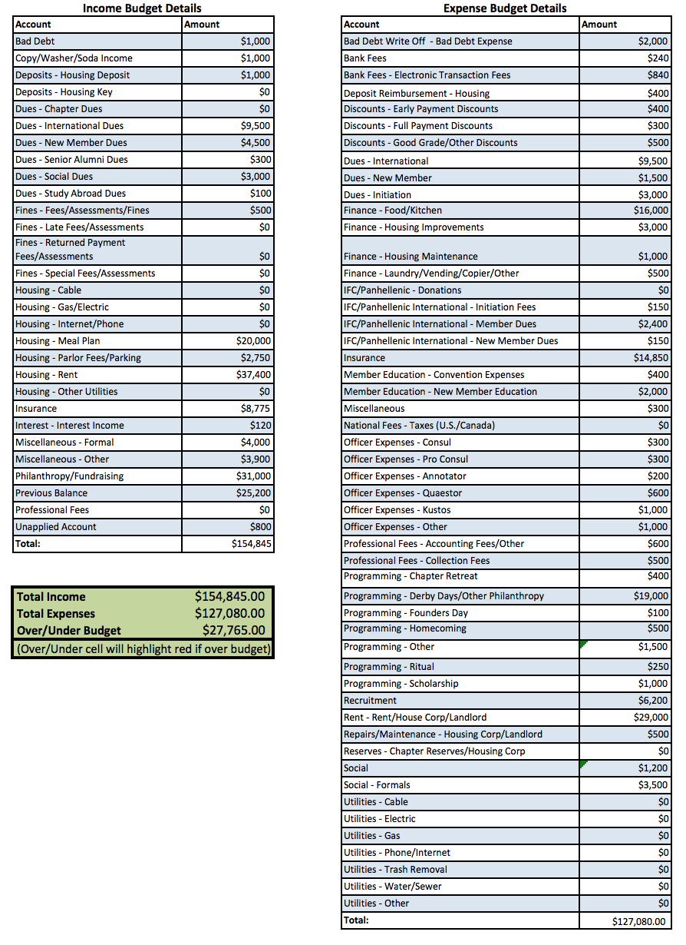
Budgeting with Software (Excel)
The Budget Builder Excel template is available in the Quaestor SharePoint Files.
The Budget Builder Includes
Asset Inputs (Income)
Liability Inputs (Expenses)
Mock Income Statement
Check Register
Payables Register

Slide 3
The Budget Builder Excel File
Quaestor vKLTW 2020 Module2 Video2
TC: 1:06-1:37

Slide 4
Asset Question-naire
Quaestor vKLTW 2020 Module2 Video2
TC: 1:38-2:26

Slide 5
Asset Question-naire Examples

Slide 6
Expense Question-naire

Slide 7
The Budget

Slide 8
Back to the Budget

Slide 9
If you use Greekbill

Slide 10
Mock Income State-ment

Slide 11
Bank Register

Slide 12
Thank you!!!
Quaestor

