Slide 1
Introduction to Accounts Payables
Quaestor

Slide 2
Accounts Payable
Accounts Payable are monies owed by the chapter to other persons or entities.
It’s the responsibility of the Quaestor and the Financial Committee to ensure that all liabilities are paid on time.
To ensure liabilities can be paid, collection of monies owned to the chapter take priority.
Accountability to our Financial Obligations are Mission Critical!
Notes:
3 ASSETS

Slide 3
A Culture of Responsible Financial Accounting
Make every attempt to apply receivables to their associated payables.
Utilize all possible resources available to collect monies and fulfill the financial obligations of the chapter!
The Buck Stops with the Quaestor!
Notes:
2 ASSETS

Slide 4
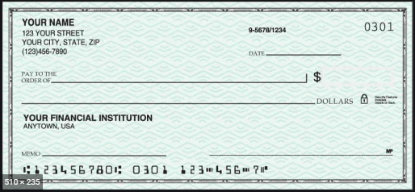
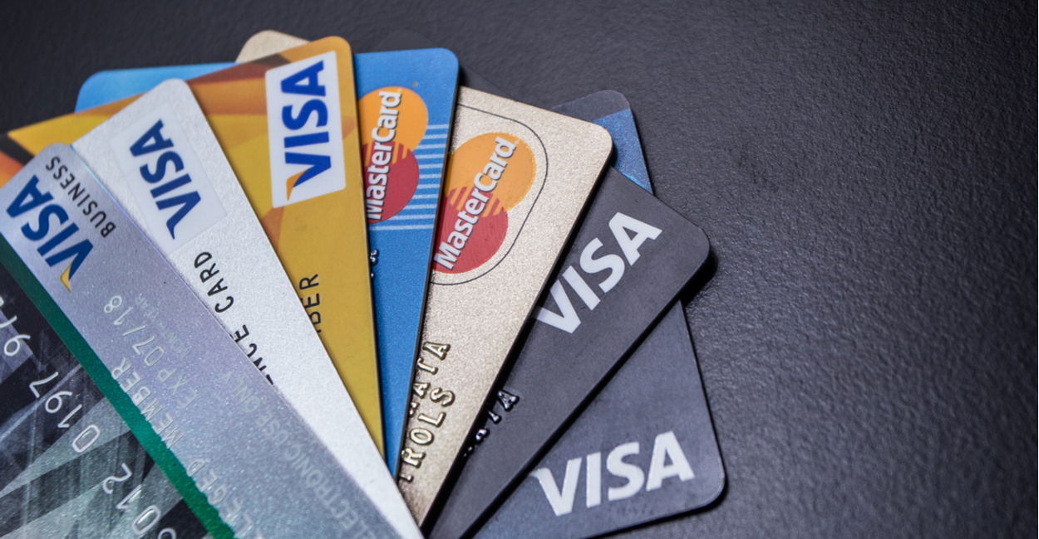
Keep it Simple, Easy, and Accountable
Notes:
4 ASSETS

Slide 5
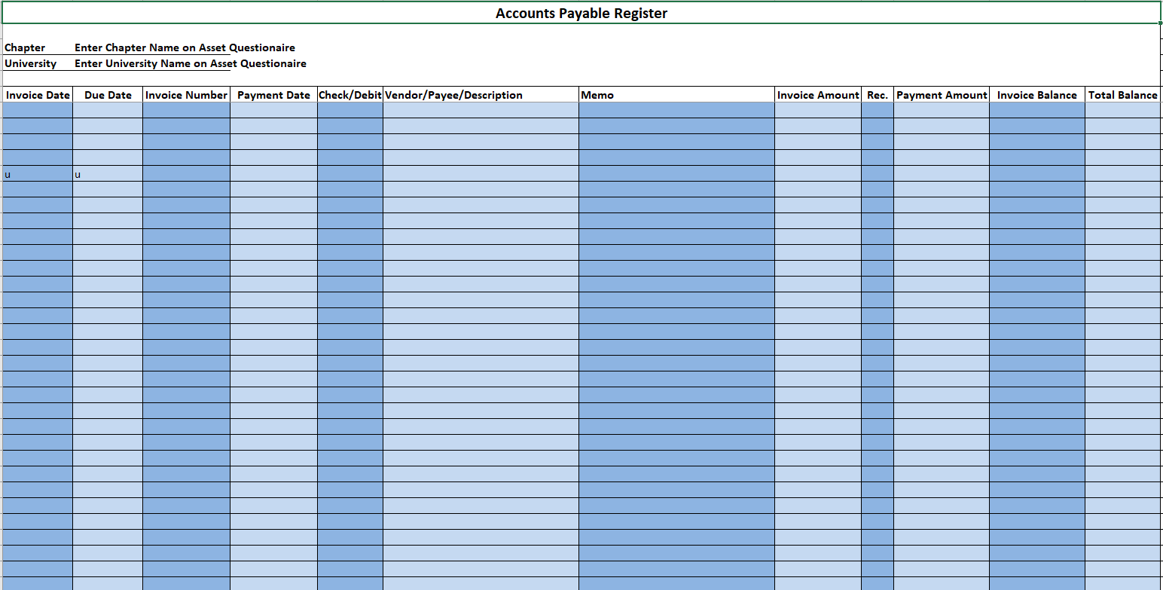
Payables Report
Review Weekly!
Notes:
2 ASSETS

Slide 6
Types of Liabilities
Pledge and Initiation Fees
Sigma Chi International Dues
Interfraternity Council Dues
Risk Management Foundation Fees
Rent
Utilities
Philanthropic Donations
Notes:
7 ASSETS

Slide 7
Payables Tracking
Notes:
3 ASSETS

Slide 8
Payment Methods

Slide 9
Payment Methods
The Quaestor and Financial Committee should ALWAYS approve all expenditures!

Slide 10
Thank you!!!
Quaestor

