Slide 1
Introduction to Budgeting
Quaestor

Slide 2
Basics of Budgeting
Assets
Collected Dues
Collected Rent
Fundraising
Liabilities
RMF Insurance
Rent
Utilities
The Budget Serves as a frame work for Cash Flow Planning!

Slide 3
Considerations of Budgeting
Budget items vary from year to year
Your Income will vary and is based on size of the chapter…
New Members…Graduates…Transfers
Your expenses will vary…
Last Year’s
Budget
Don’t just cut and paste last year’s budget into next year!

Slide 4
Considerations of Budgeting
Using Historical Data
Utility Bills
Officer Budgets
Alumni Financial Advisors
Past Quaestor
Looking back and give you clues to looking forward!

Slide 5
Considerations of Budgeting
Underestimate Assets…Overestimate Expenses
Assets
Expenses
Being conservative in your estimations protects the financial health of the chapter!

Slide 6
Considerations of Budgeting
Partnering with your Officers…
“What are you trying to accomplish?”
“Is that a necessary investment of your budget?”
“What assets do you think you will need to accomplish your goals?”
“How many different bids did you consider?”
Direct questions lead to direct answers!

Slide 7
Considerations of Budgeting
Be prepared to trim your budget…
The goal is to come out with POSITIVE cash flow!

Slide 8
Considerations of Budgeting
Obtain approval from your financial committee and chapter!
The goal is to come out with POSITIVE cash flow!

Slide 9
Considerations of Budgeting
Chapter Debit and Credit Cards
Be very stringent with your card policies!!!

Slide 10
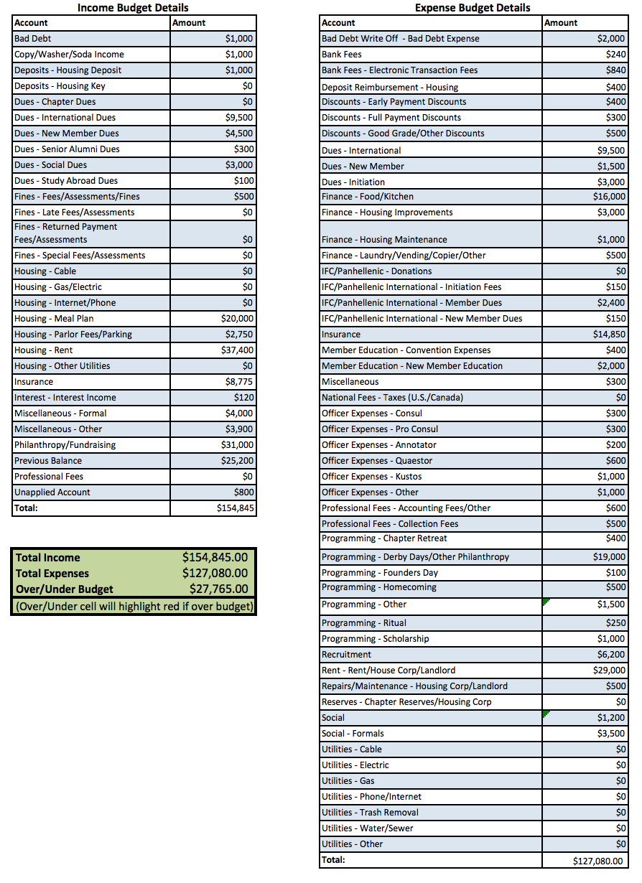
Budget Example
Expenses
Income
Your budget worksheet is a living document!!!
Budget Analysis

Slide 11
Thank you!!!
Quaestor

