Slide 1
Time Management Resources
Quaestor

Slide 2
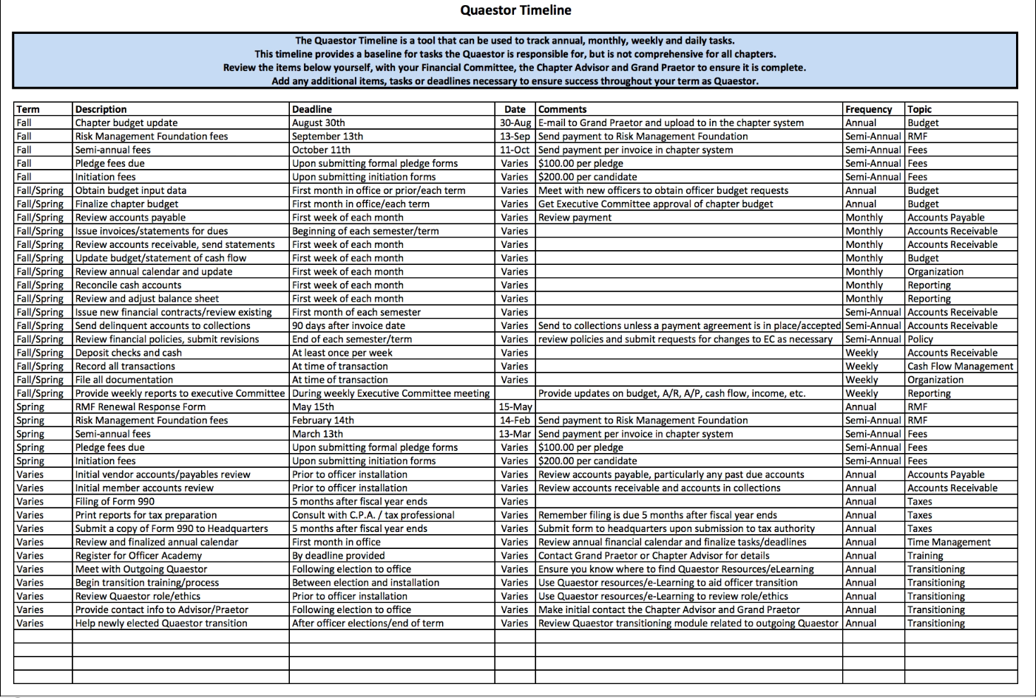
The Quaestor Timeline
Weekly
Monthly
Semi-Annual
Annual

Slide 3
The Prioritized To-Do List

Slide 4
The Prioritized To-Do List
Quaestor vKLTW 2020 Module1 Video2
TC: 10:57-12:35

Slide 5
The Prioritized To-Do List – Instructions Tab
Quaestor vKLTW 2020 Module1 Video2
TC: 13:27-13:43

Slide 6
Time Blocking

Slide 7
Time Blocking
Quaestor vKLTW 2020 Module1 Video2
TC: 13:57-14:46

Slide 8
Thank you!!!
Quaestor

