Slide 1
Introduction to Accounts Receivables
Quaestor

Slide 2
Account Receivable
Accounts Receivable are monies invoices by the chapter that are not yet paid.
Friendship and Finances
One of the hardest tasks in Sigma Chi is holding your brothers accountable to their financial Obligations

Slide 3
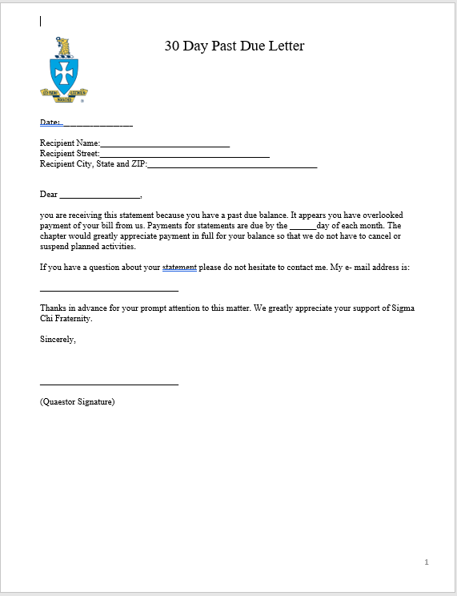
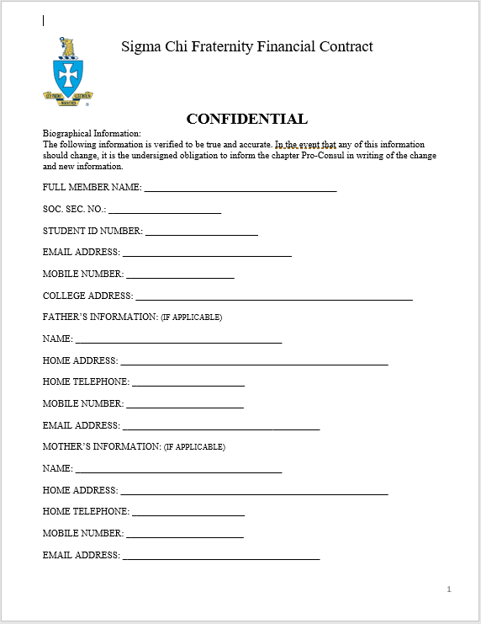
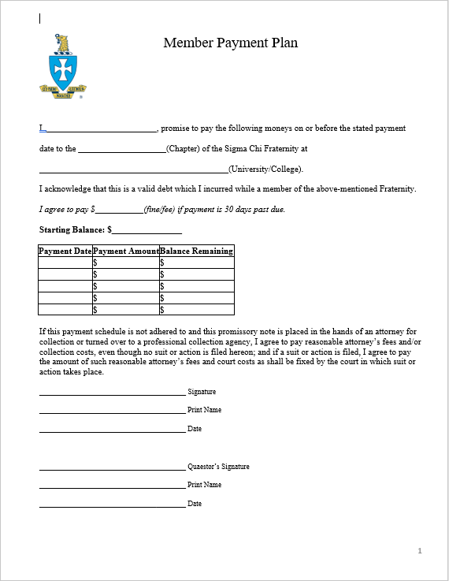
Your Resources
Financial Contracts
Regular Statements
30/60/90 Day Letters
Payment Plans
Financial Committee
Collections Services

Slide 4

You are NOT alone!
Financial Committee
Chapter Advisor
Housing Corporation
Executive Committee
Remember…Be courteous in your efforts while maintaining Accountability.

Slide 5
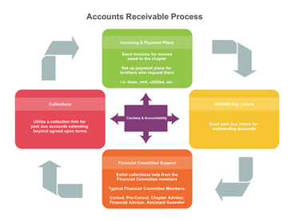
Accounts Receivable Process
Signatures are Critical!

Slide 6
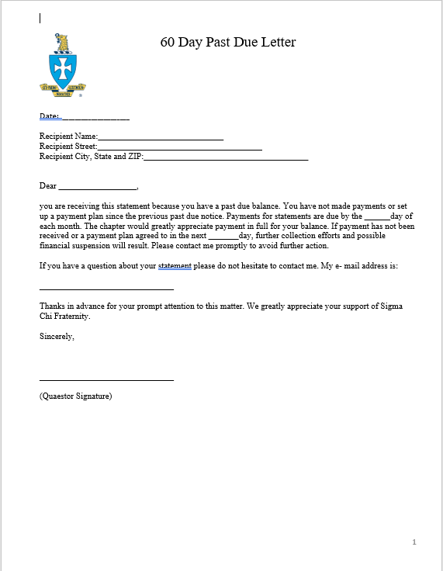
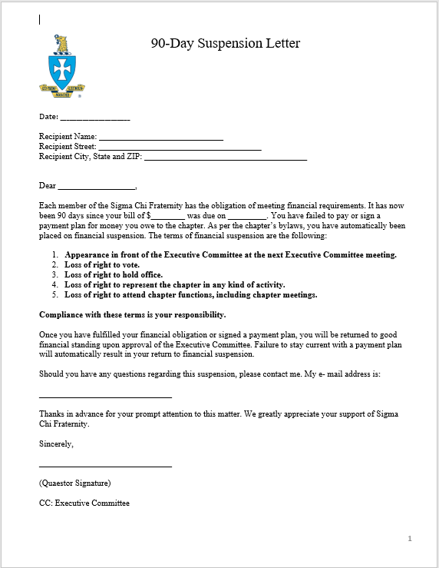
Past Due Letters

Slide 7

Financial Committee and Alumni Support
Financial Committee
Quaestor
Assistant Quaestor
Financial Committee Members
Chapter Advisor
Don’t forget to utilize support from your Executive Committee!

Slide 8
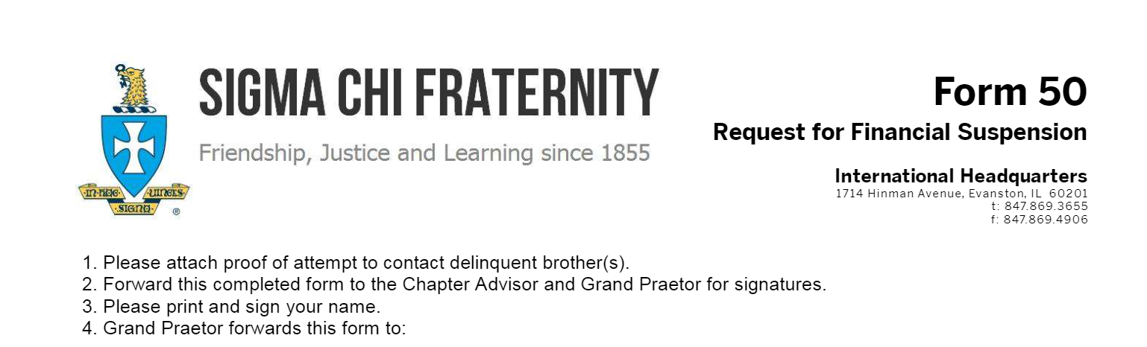

Collections
Delinquent Accounts should not be ignored!

Slide 9

3rd Party Collections Services

Slide 10
Thank you!!!
Quaestor

